Slide 1
Big Data, A.I. and Investing
Ken Liu

Slide 2
Introduction to Big Data
Introduction
Examples
Demo: Datatact Web
Datatact workflow and techniques
Discussion: Usage of Big Data Applications
Demo: Datatact System and Architecture
Big Data Technologies

Slide 3






My Background
Study Computer Science
iBanks Algo trade technologist
Startup on Quant Trading, Big Data and AI

Slide 4

My Work
Sub-header/text/chart/table

Slide 5

My Work
Sub-header/text/chart/table

Slide 6
Course Objectives
Appreciate the current technologies on investing and trading
Challenges of the financial industries
Deeper understanding of the buzz and trends on Big Data and AI
Myths vs Truths
Big Data not only Hadoop
AI not only Deep Learning
AI is not equal to Human Intelligent (as least not now)

Slide 7
Course Overview
Big Data Processing and Analysis
Sentiment Analysis & NLP (Natural Language Processing)
Automated Trading (Algorithmic Trading)
Artificial Intelligence and Predictive Analytics
Challenges of Deep & Reinforcement Learning (Alpha-Go)

Slide 8
Assessment
Continuous Assessment
In-class computer assignment which include the usage of different applications & methodologies
Final Assessment
15-mins (3-5 persons) group project presentation which integrate knowledge in this module, apply different AI methodologies and software to process big data and interpret the results that leads to investment decision making practically.

Slide 9
Approach
Interactive
Feedback & discussions
Experiments
Have fun
Real-World Examples
Datatact Web
Trading Systems
Industry Experience Sharing
Electronic Trading Desk
Algo Trading Strategies
How big firms trade stocks
Big Data and AI startup

Slide 10
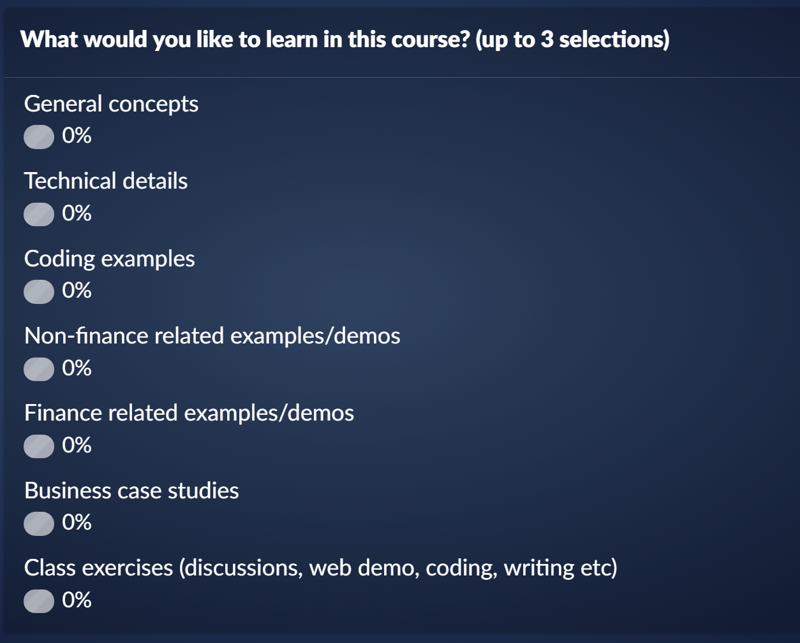

Your Input…….
sli.do
bdaii1

Slide 11

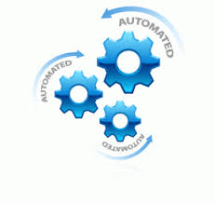
Key Themes
Portfolio (what do buy)
Stock Pickings
Fundamental: values, prospects
Quantitative: statistics, models
Trading (how to buy)
Algorithmic Trading
HFT (High Frequency Trading)
Program Trading

Slide 12
Roles of Humans and Machines
Short term trading: (e.g. high frequency, market making) humans already play a very small role.
Medium term investment horizon: machines are becoming increasingly relevant. It can quickly analyze news feeds and tweets, process earnings statements, scrape websites, and trade on these instantaneously. These strategies are already eroding the advantage of fundamental analysts, equity long-short managers and macro investors.
Long term horizon: machines will likely not be able to compete with strong macro and fundamental human investors (yet !?). Machines will likely not do well in assessing regime changes (market turning points) and forecasts which involve interpreting more complicated human responses such as those of politicians and central bankers, understanding client positioning, or anticipating crowding.

Slide 13
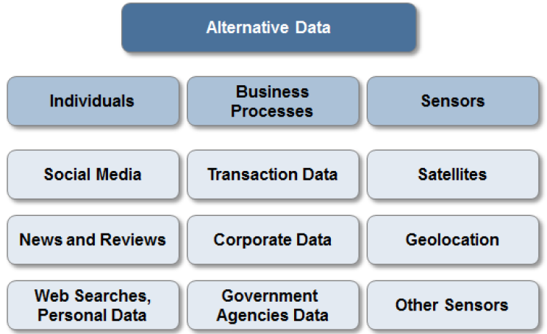
Trend #1: Data, Data, Data….

Slide 14

Individuals: Social Media
Apple co-founder Steve Wozniak: "Apple makes its money off of good products, not off of you," Wozniak said. "As they say, with Facebook, you are the product.“
TIME Person of the Year 2006
You
(Question: how Google Map Track the traffic? )

Slide 15
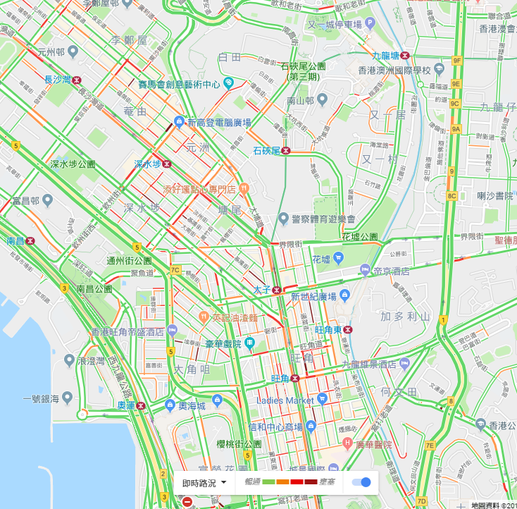
Individuals: Digital Footprints
Mobile Data (GPS): Google Map traffic analyzing the GPS-determined locations transmitted to Google by a large number of mobile phone users. By calculating the speed of users along a length of road, Google is able to generate a live traffic map https://en.wikipedia.org/wiki/Google_Traffic
Web search trend https://trends.google.com/trends/
Personal email http://www.superfly.com/

Slide 16
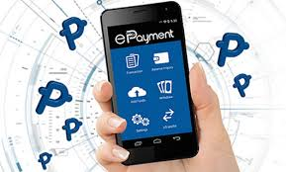
Business Processes
Public agencies (e.g. federal and state governments) https://data.gov.hk/en/
Commercial transactions (including e-commerce such as AliPay and WeChat, credit card spending, exchange transaction data)
Private agencies (e.g. industry specific supply chain data, intra-day tick data from the exchange)
Other ideas:
Amazon: track the best sales products and break down the underlying raw material for investing
Gov open data (such as pollution index, beach water quality): track health for pharmaceutical stocks

Slide 17
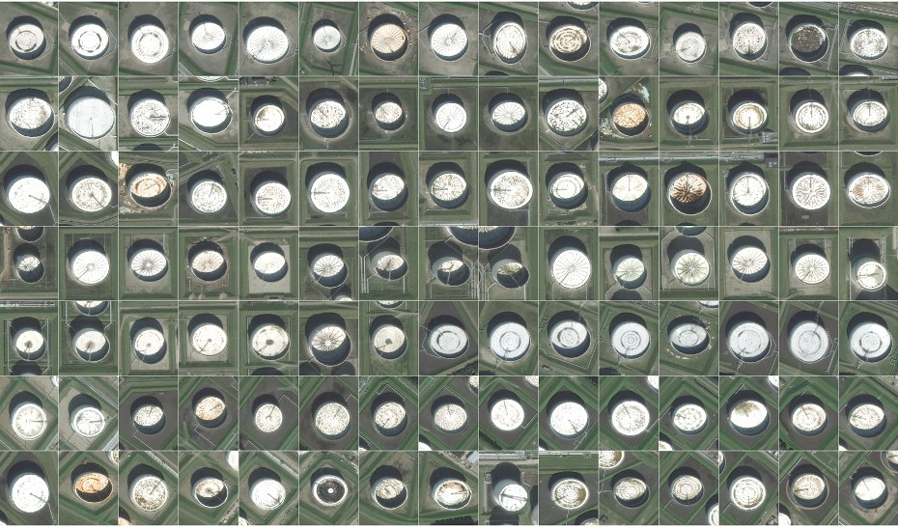
Satellite image: Oil Reserve
Oil reserves are often stored in floating tanks around the world, whose lid rises and falls with increasing or decreasing storage. With the rising and falling height, the crescent-shaped shadows cast by the sun also change shape. By tracking these shape changes (Deep Learning - CNN), Orbital Insights predicts oil inventory levels. https://www.wired.com/2015/03/orbital-insight/

Slide 18
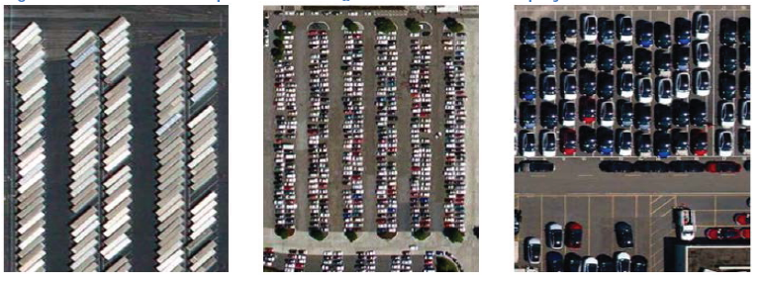
Satellite image: Parking Lots
Satellite Imagery of Parking Lots and Trading Retail Stocks from RS Metrics - uses ~10 high-resolution satellites, orbiting the Earth and imaging between the store opening hours. Such data can be used to estimate retail traffic (e.g. at some ~50 retail chains)
Other Ideas:
Road cameras (video) to gauge car brands popularity
In class students facial expressions to predict the class effectiveness

Slide 19
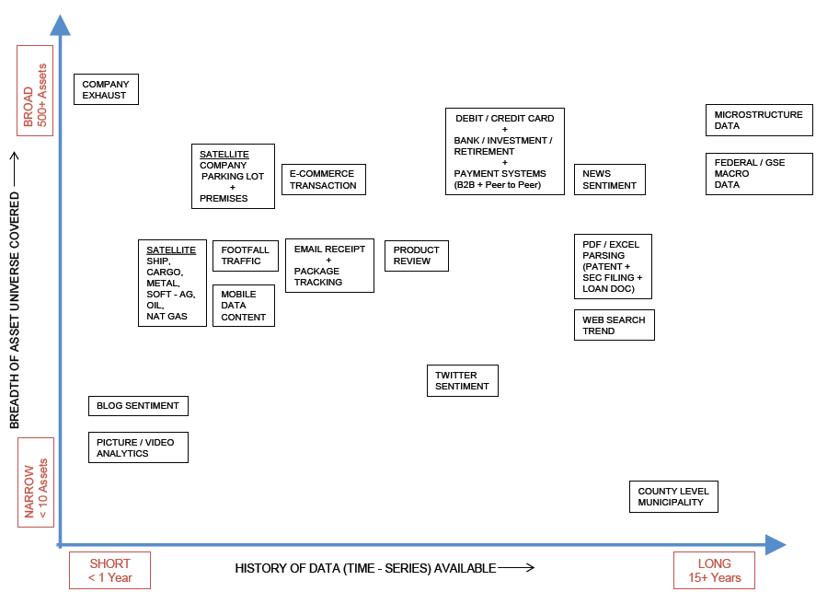
Alternative Data Summary

Slide 20
Trend #2: AI, AI, AI………
Chatbot
Natural language Q&A
Sentiment Analysis
Robo Adviser
Algorithm driven portfolio construction
Big Data & AI ETF
Automated Trading
Computer driven buy & sell of stocks
Trading signals: momentum/correlation

Slide 21
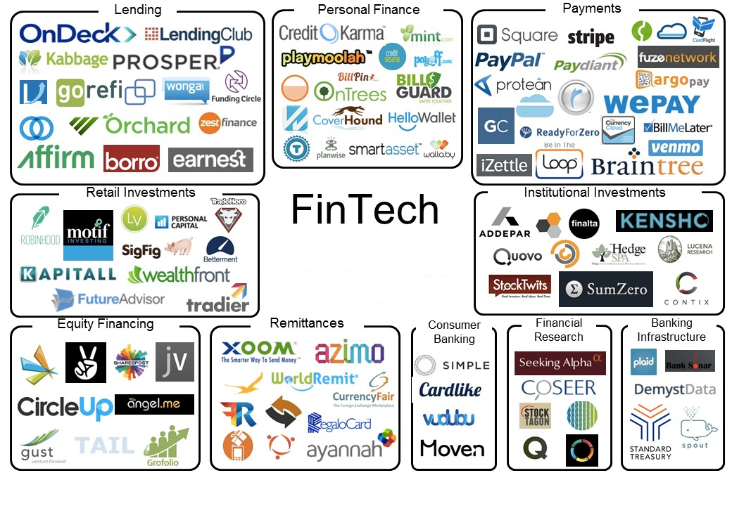
Fintech

Slide 22
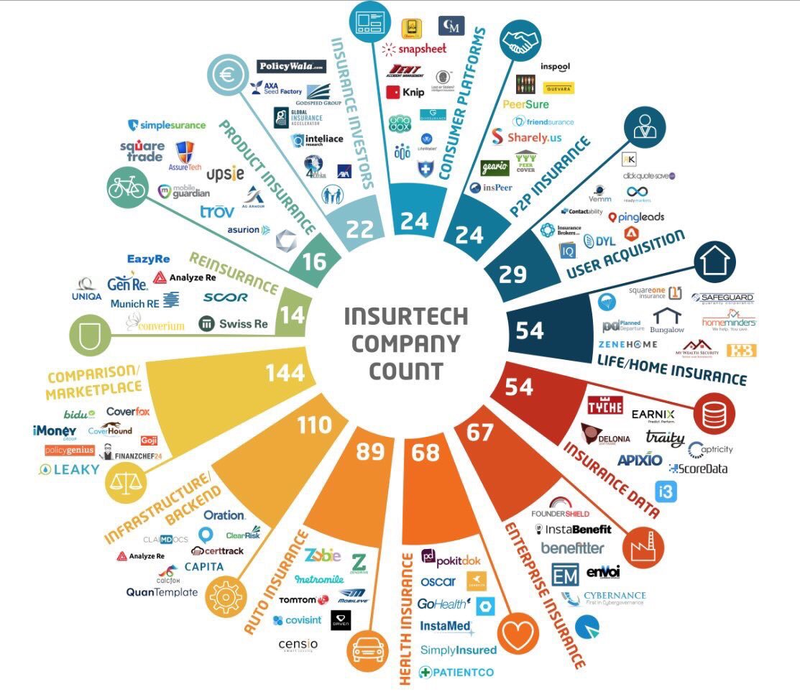
Insurtech

Slide 23
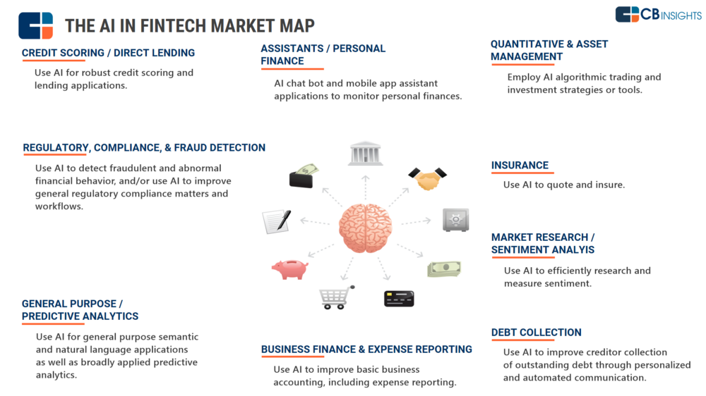
The AI in Fintech & Insurtech

Slide 24
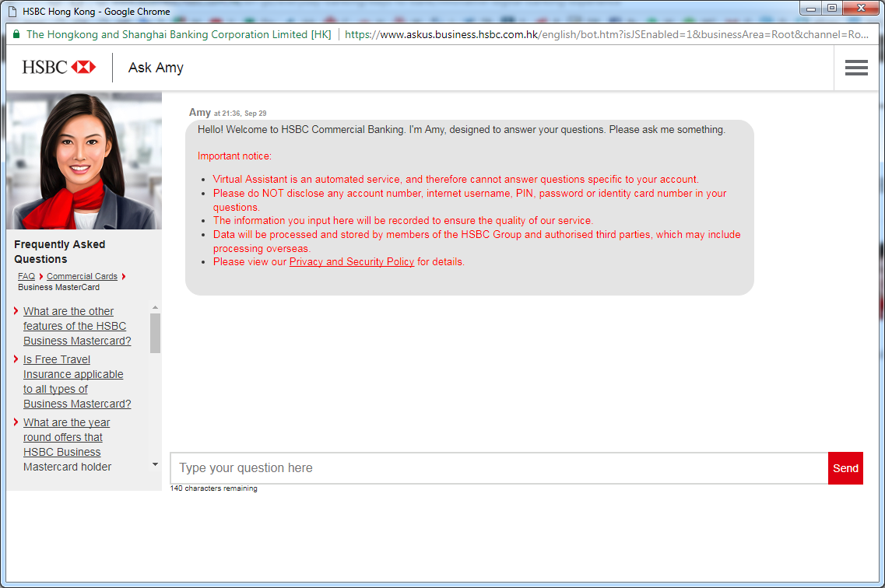
Example: HSBC Ask Amy Chatbot
Give it a try

Slide 25
Example: Amazon Alexa
Incoming customer call
Hi Nikki Wolf, based on unusual activity, we have locked your Credit Card. Is your call related to this? If so, please enter the onetime code sent to your phone.
Sure, the code is 12345.
Thank you. Your credit card is now unlocked and you should be able to proceed with the transaction.
Great, thank you!
CRM content
Data
Dip
DYNAMIC Amazon Connect answers customer questions before they are asked
PERSONAL Contact flows adapt on a per customer basis
NATURAL Connect integrates with Amazon Lex to give the apply speech recognition and natural language understanding technology that powers Alexa to customer interactions
Voice Usage in TV program selection (e.g. myTVSuper)

Slide 26


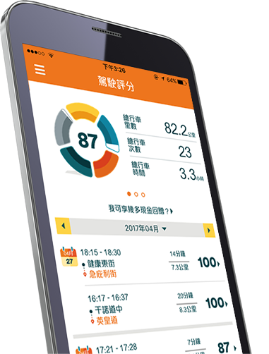
Example: Insurance Apps
Manulife Move
AXA Xtra
FWD Drivamatics

Slide 27
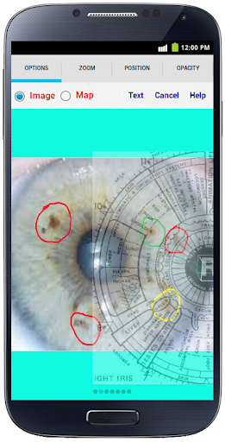
Example: Personal Health
Iridology: BiliScreen uses a smartphone camera, computer vision algorithms and machine learning tools to detect increased bilirubin levels in a person’s sclera, or the white part of the eye
https://www.alliancehealth.org.nz/tech-talks/data-digital-ai-app/app-uses-smartphone-selfies-to-screen-for-pancreatic-cancer
https://www.researchgate.net/publication/262876553_The_Smart_Device_for_Healthcare_Service_Iris_diagnosis_application
Idea: Food for Diet Analysis

Slide 28
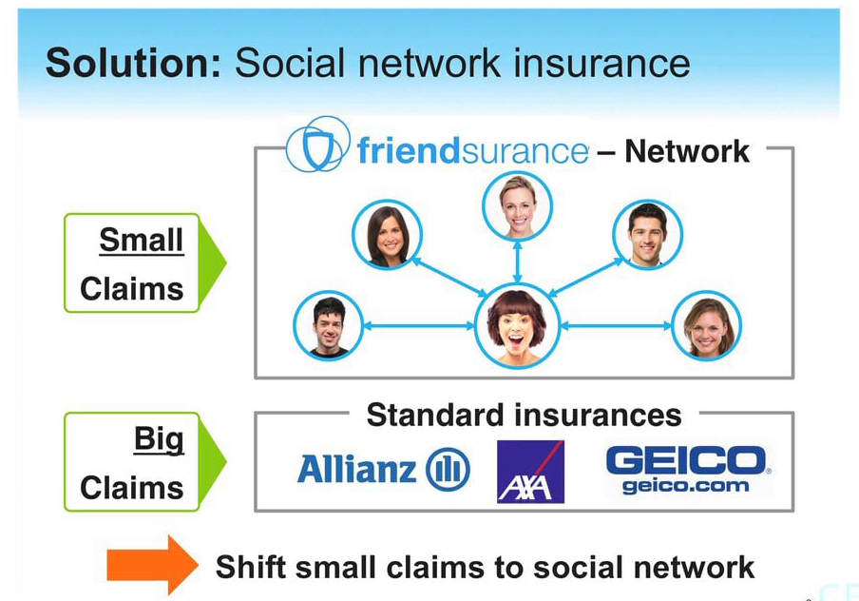
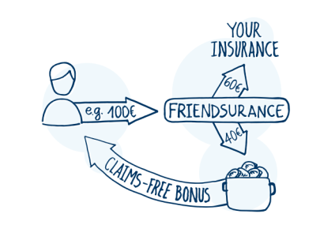
Example: P2P Insurance
Friendsurance: P2P Insurance. “If there are zero or just a few claims, the members of the group receive a share return from the cashback pool. Insurance customers enjoy full coverage and never pay more than they would.

Slide 29
Example: Machine Readable News
Thomson Reuters
As markets become ever more automated, the window to profit from market events is small and shrinking. And with news driving market volatility, getting news quickly to avoid losses is critical.
However news and events aren’t easy for machines to consume. The content is unstructured making it difficult to take action before the market moves and virtually impossible to extract a key number such as EPS at machine speed. For strategy research or regulatory analysis looking for correlations between news and market moves, finding historical structured news and linking it to price histories is burdensome.

Slide 30
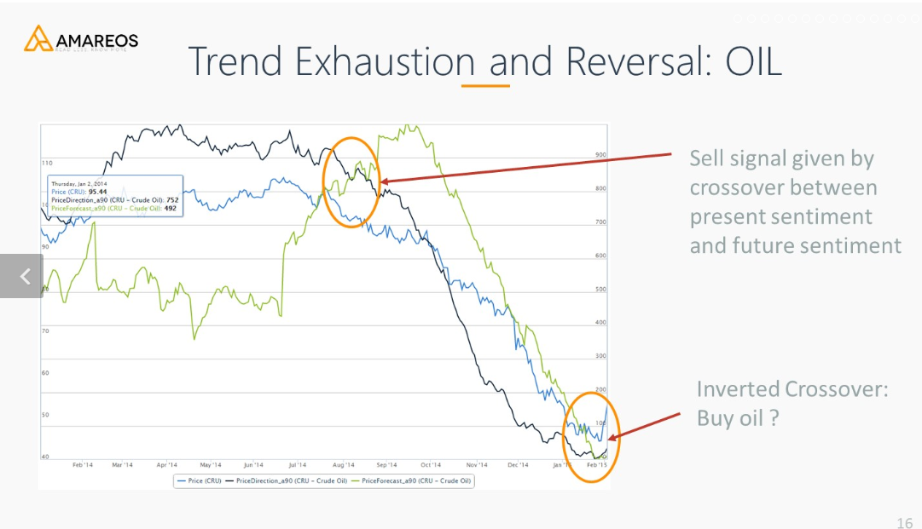
Example: AI Investment
Sentiment Analysis

Slide 31
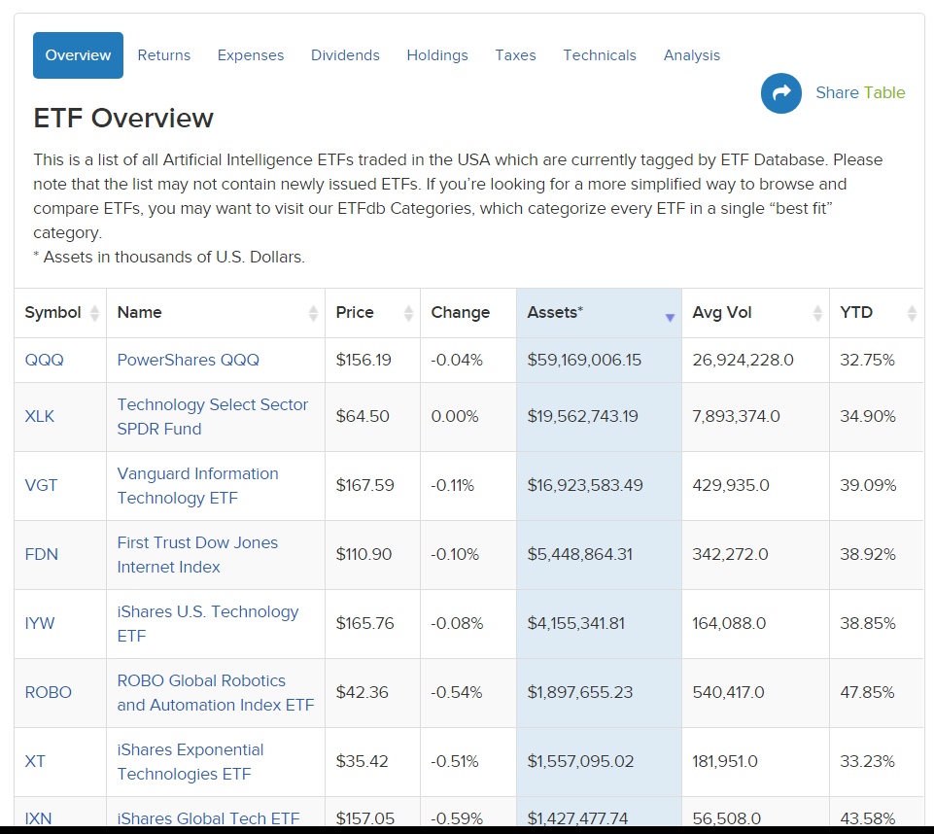
Example: AI ETF
Robo-Advisor (AI ETF) and leverage big & alternative data source
Text: Social Media, News
Images: satellite image on oil fields
Videos: road cameras of cars

Slide 32
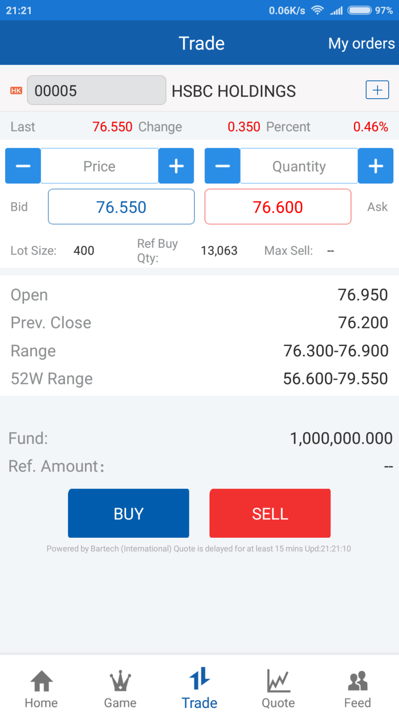
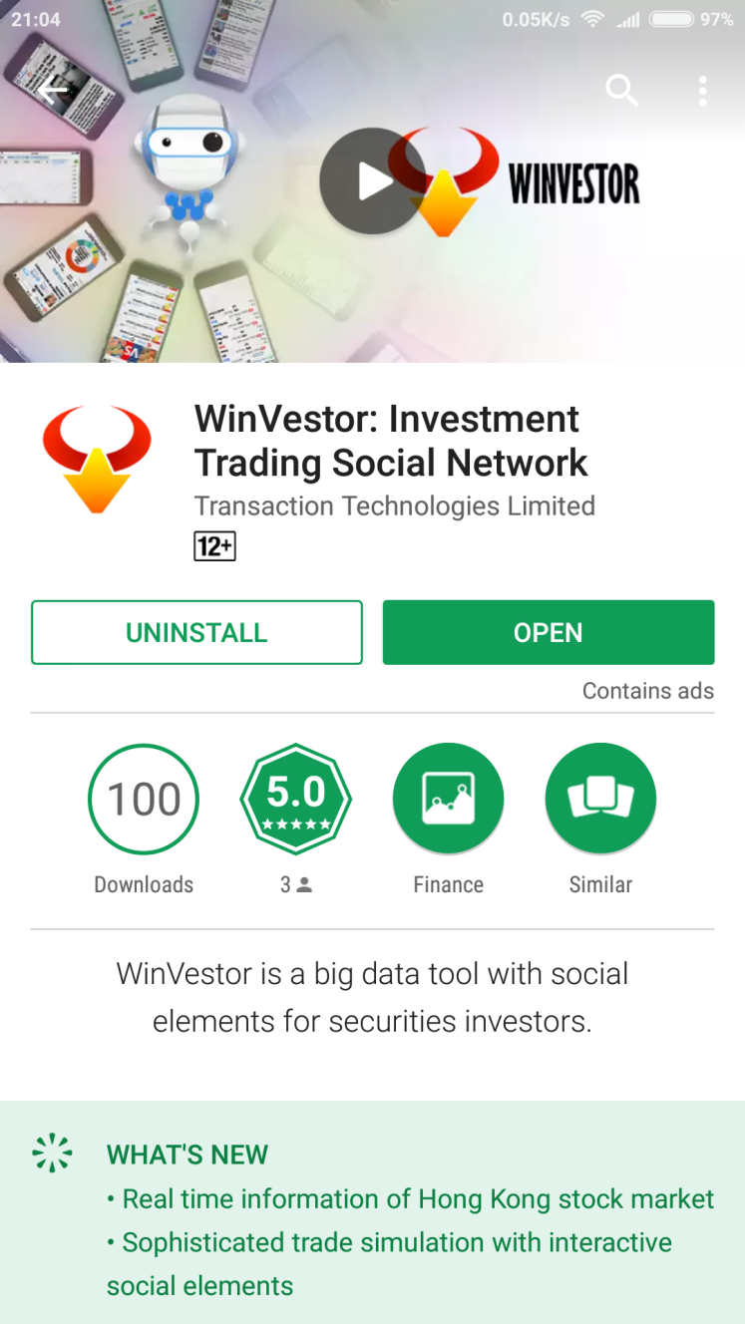
Example: Social Trading
WinVestor
Download from App or Play Store
News Analytics
Market Data
Trading Games

Slide 33
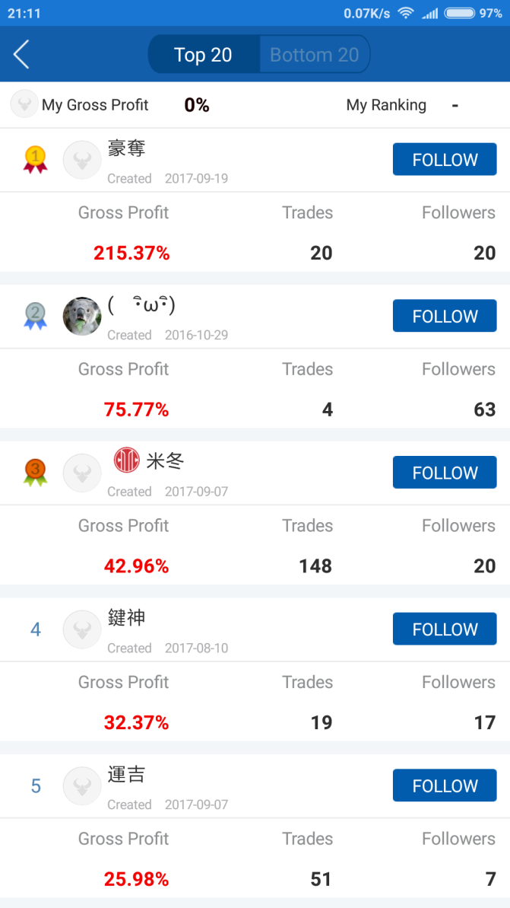

Example: Social Trading
Learn user trading patterns and behaviors
Money-making users can get paid for viewing their profitable portfolios and transaction notifications

Slide 34
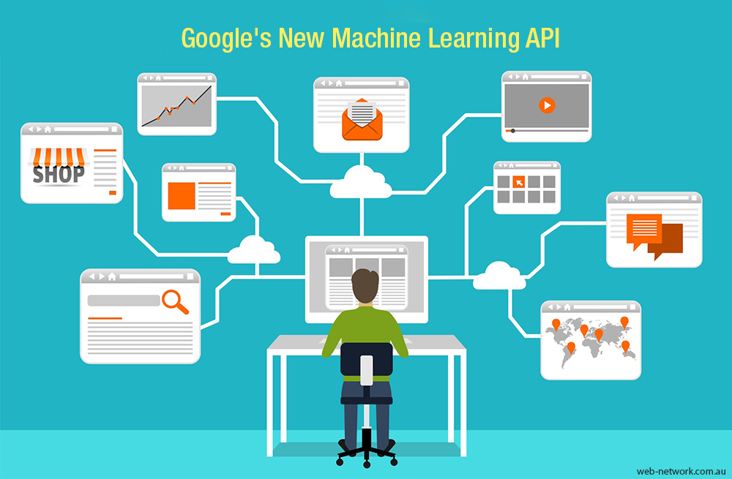
Demo: Google AI Cloud
Natural Language Processing
Image Analysis

Slide 35
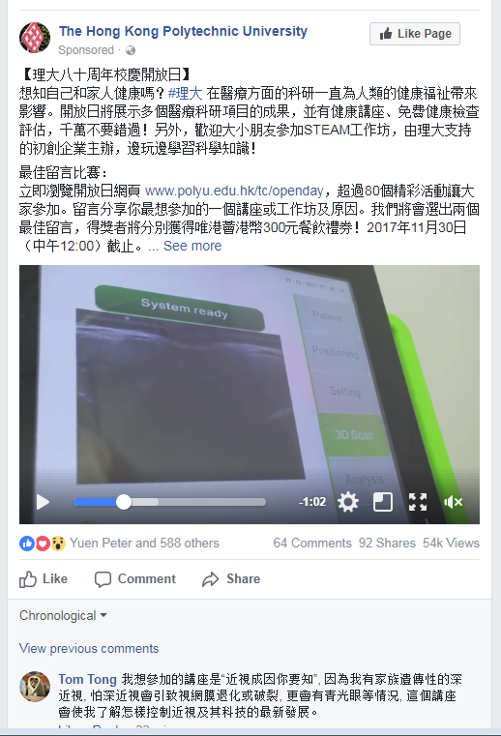
Datatact Web
Social Media Big Data Analytics
Fan Pages (1K +)
Posts (2.7M +)
Comments (35M +)
Reactions - Like, Love, Haha, Angry, Wow, Sad (50M +)
Shares (5M +)

Slide 36
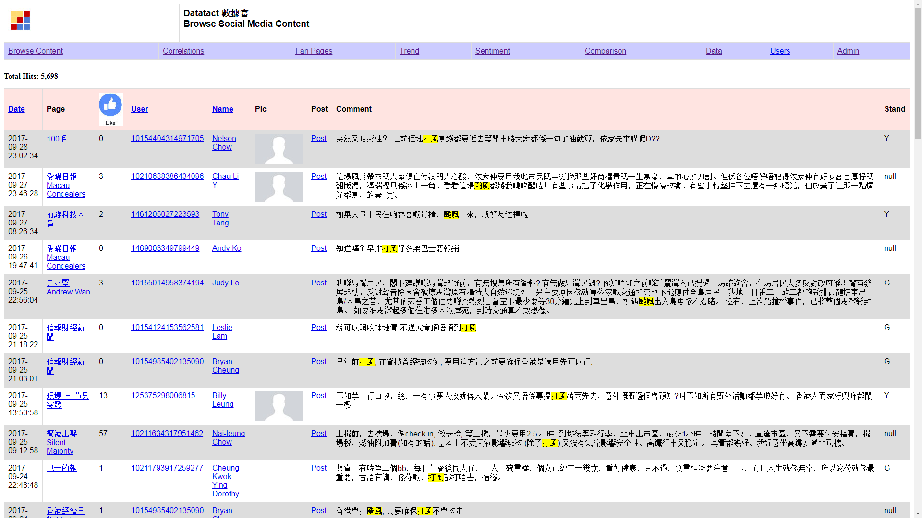
Datatact Web
Keyword Search:打風 颱風

Slide 37
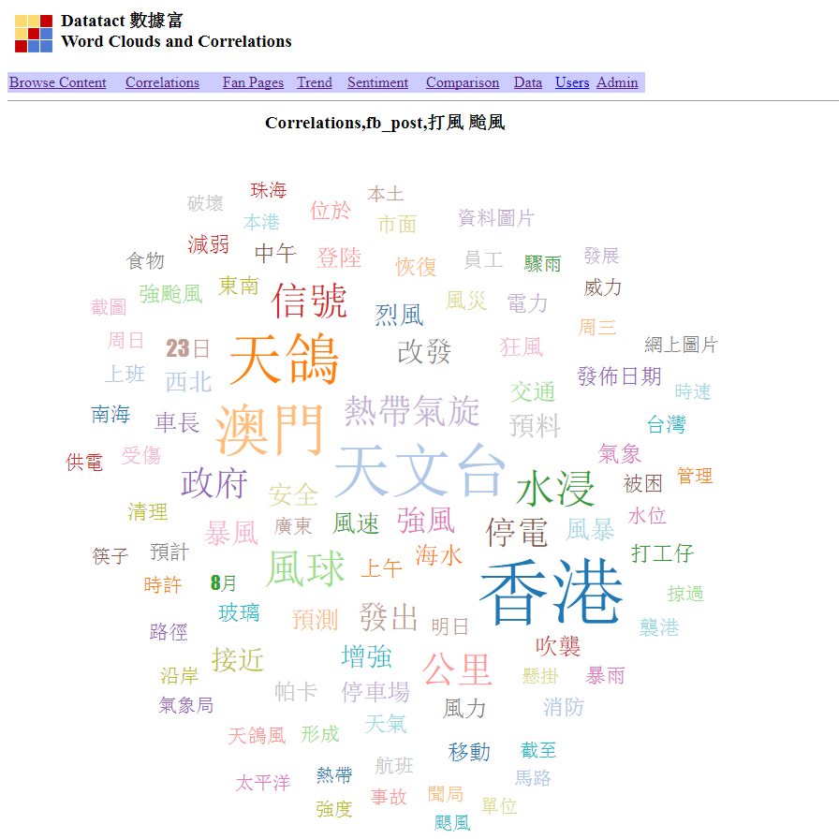
Datatact Web
Correlation:
打風 颱風

Slide 38
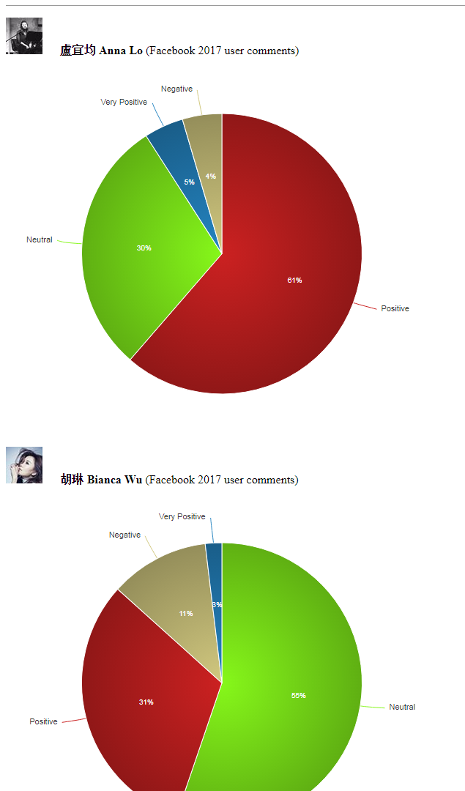
Datatact Web
Sentiment: Based on Facebook user comments on the Fan Pages

Slide 39
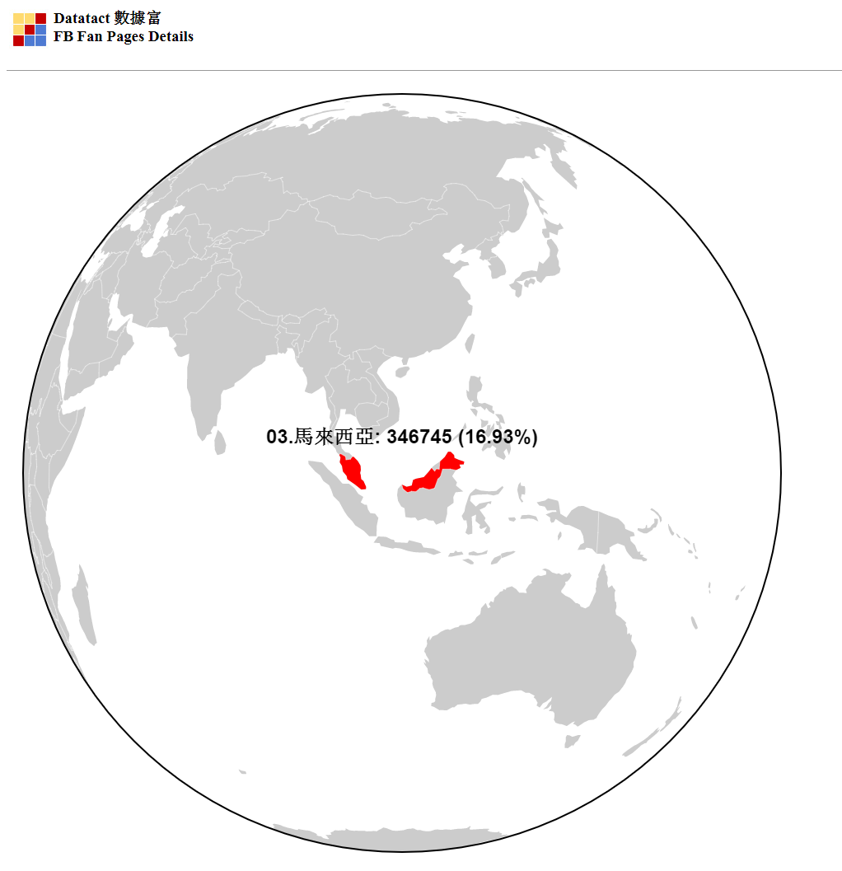
Datatact Web
Visualization: Fan Pages users by countries

Slide 40
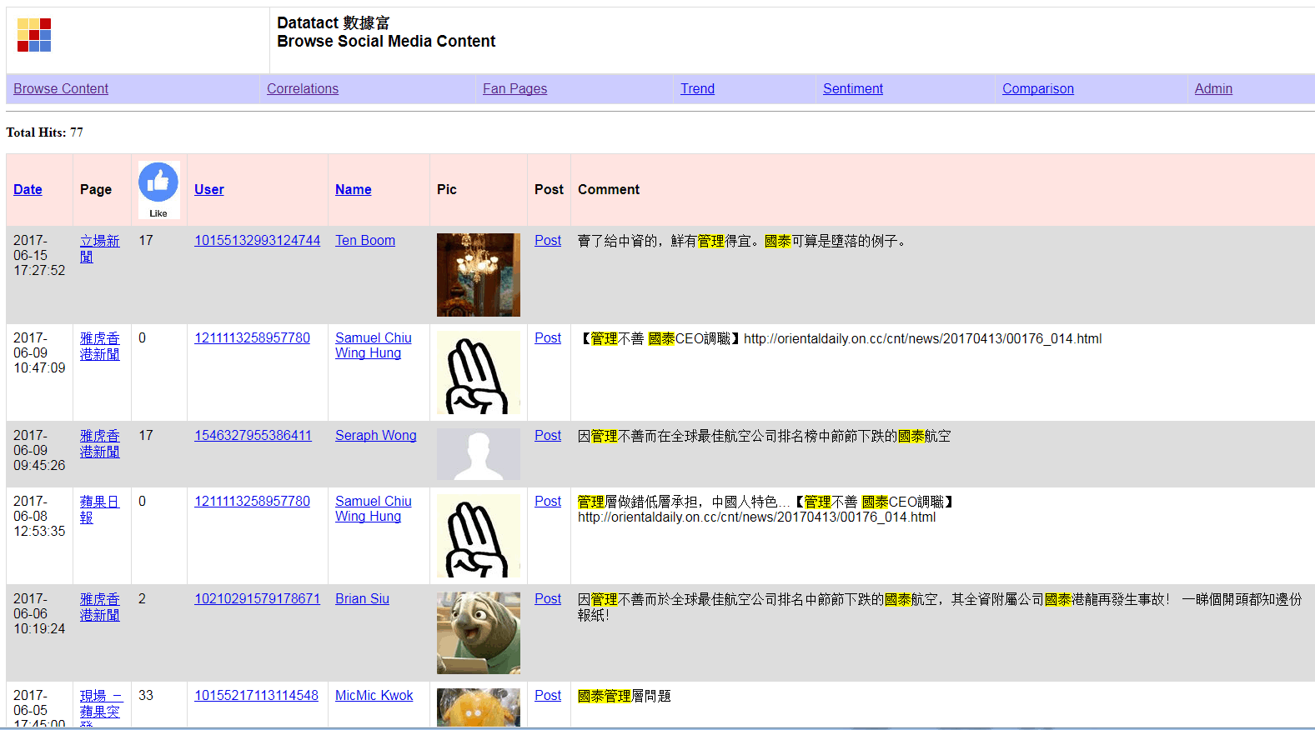
Datatact : Social Listening
Public images of Cathay Pacific
2017/07/12

Slide 41
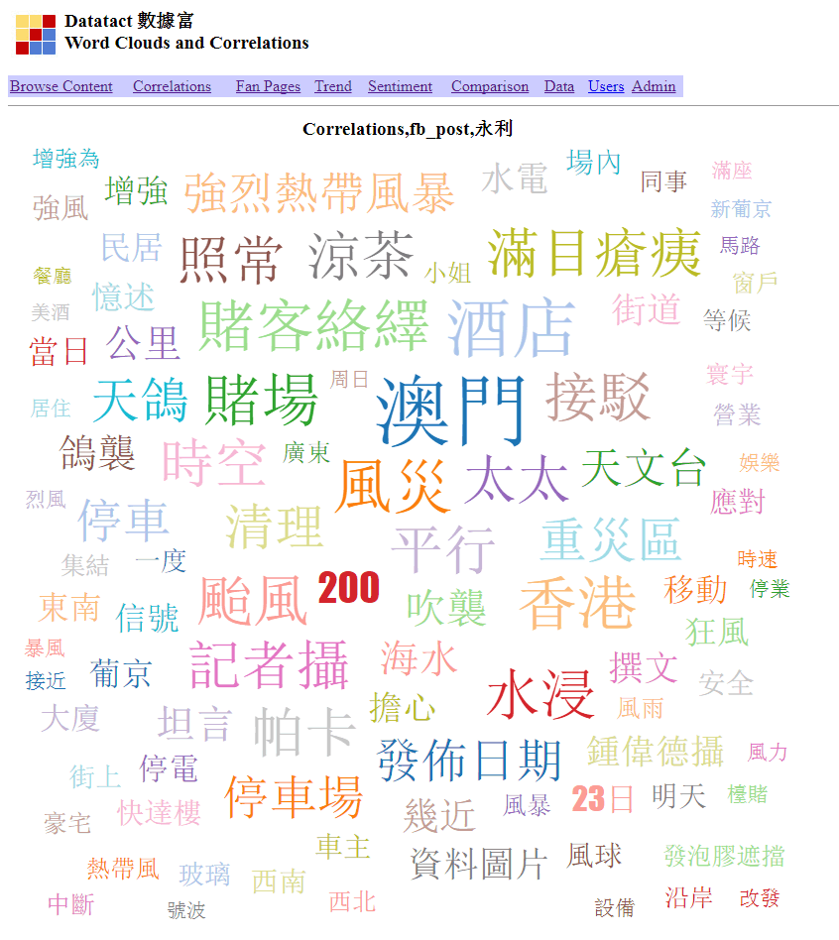
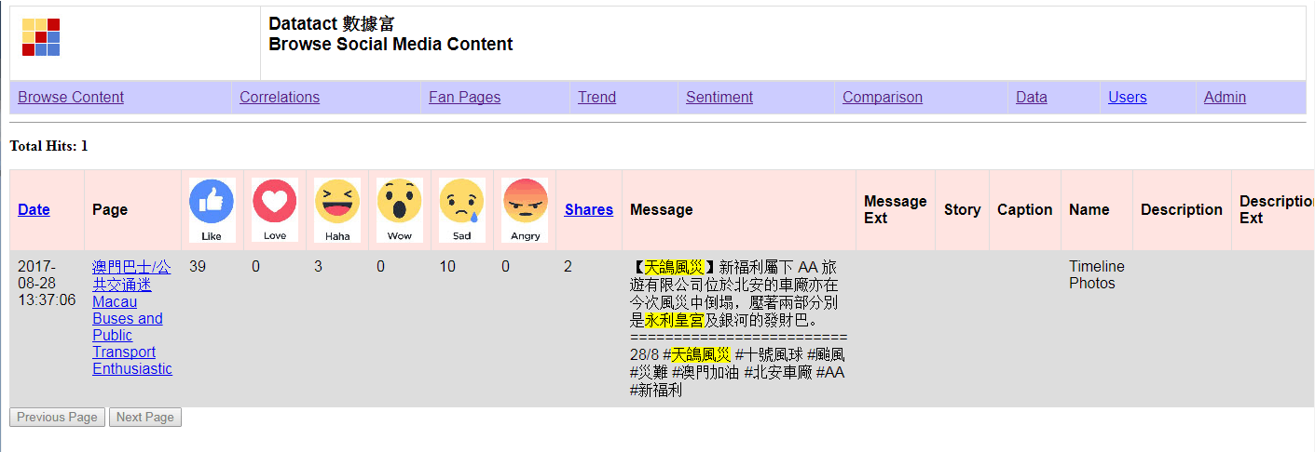
Datatact : Social Listening
Impact of Hato Typhoon to Macau Casinos (Wynn)
2017/08/30

Slide 42
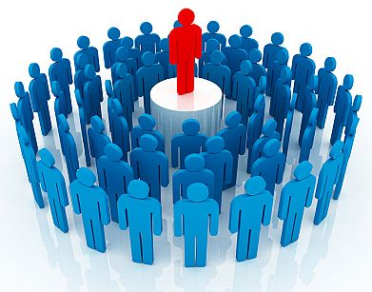
Datatact : Crowd Opinion Leader (COL)
Every customer is also a marketer
Disrupt the marketing industries by linking the brands to the customers directly where the customers are both their marketers and buyers at the same time

Slide 43

Datatact : Crowd Opinion Leader (COL)
Big Companies: Apart from knowing someone’s interest on a particular brand or product, it’s also important as who’re selling to them. Many people will turn down a promotion from a stranger (sales or marketer). Even if the call/message is from the brand itself, they may consider it as “hard sell”.
Small Companies: Established Companies have been using KOLs (Key People Leader) to promote their brands and products. However, for smaller firms, KOLs are usually too expensive and may not be cost effective. Also, there is no accurate way to measure the effectiveness of an KOL.

Slide 44
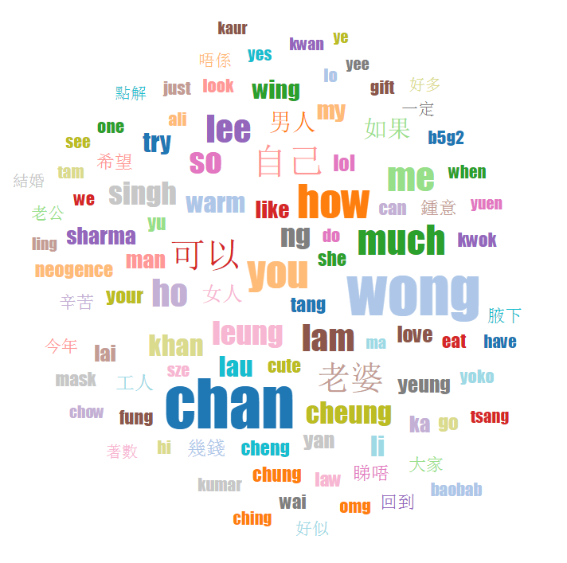
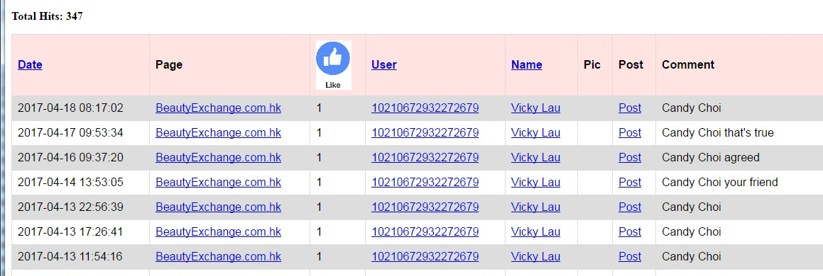
Datatact : Crowd Opinion Leader (COL)
In Social Media (like FB), friends like to tag each for certain brands and products
A word cloud from the 200 Beauty related FB Fan Pages shows that many comments are friends “names”
The details reveal a particular user tagging her friend frequently

Slide 45
Datatact : Crowd Opinion Leader (COL)
Observations
Those users who are actively tagger their friends for products are, in a way, helping to market the brands
Through the network of friends, it would be easier to sell the products as it solved the issue of talking to a strangers
There can be a timing benefit as a friend may know another friend who is currently looking for a particular product
Goals
Turn people into COLs (e.g. our data reveals who are most active on certain categories of products and actively tagging their friends)
Those COLs work for the brands for rewards; while the brands leverage them to increase the sales to their network of friends
Every customer is also a marketer! Linking the brands to the customers directly where customers are both marketers and buyers

Slide 46

Datatact : Crowd Opinion Leader (COL)
COL Identification
COL Profile: trace the user actions
Activity Heat Map: based on the activity metrics which include the frequency of tagging friends, reactions (likes, angry, wow, sad) to particular content or comments
Friend List: number of friends
Goals
Match the COL profile to the appropriate brands/companies
COL matching fee is based on the effectiveness (i.e. the statistics of Activity Heat Map, Feedback Rate and Friend List)
Make the COL exclusively for a company will incur additional charge

Slide 47
Datatact : Crowd Opinion Leader (COL)
Revenue Opportunities
HK market has estimated 3.76 millions active FB users in 2019
https://www.statista.com/statistics/558226/number-of-facebook-users-in-hong-kong/
Each user can be engaged in multiple expertise areas where average COL matching fees is estimated to be HK$ 1,000 per case
HK Market | Revenue (HK$)
Estimated active HK Facebook users | 3,760,000
No. of expertise area per COL | 5
Ratio of one COL to their friends | 1 to 20 (0.05)
Matching fee of each COL case | $ 1,000
Total | 3,760,000 * 5 / 20 * $1000 = $ 940,000,000 (940 M)
Capture 5% of the total | 5% * 940,000,000 = $ 47,000,000 (47M)

Slide 48
Development Pipelines
Facebook & Web Data Extraction
Storage (Database)
Pre-process: Cleaning, Small Caps, Tokenize
Post-process: Remove StopWord, Word Stemming
Index
Search Query
Relevance and Sorting
Visualization & Interpretation

Slide 49
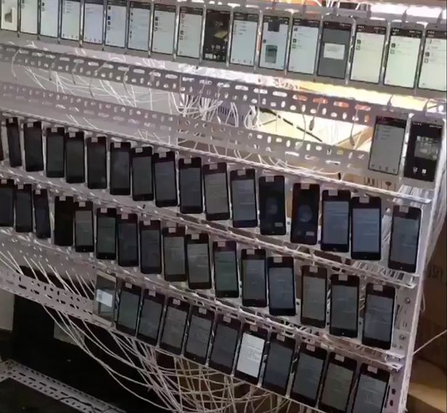
Data Extraction & Storage
Data Extraction
Manage Facebook account
Disconnect and retry
Throttling
Web Scraping
Privacy limitation (Cambridge Analytica Scandal: Facebook Allowed Firm To Exploit Data To Target American Voters)
Storage
Durable
Handle concurrency (multiple writer)
Fast retrieval

Slide 50
Pre Process
Cleaning
Remove symbols (, [ ] \ ! # etc)
Remove URLs
Small Caps
Convert all English letters to small caps
Tokenize
Break the sentence into words
English is easy but Chinese is not
Example:
各位父母買零食要留意
各位 父母 買零食 要 留意 (with space between each phrases)

Slide 51
Post Process
Remove Stop Word
English: a an the
Chinese: 的 了 嗎
Word Stemming
English: stems stemmer stemming stemmed
Chinese: 香港大學, 港大, hku

Slide 52
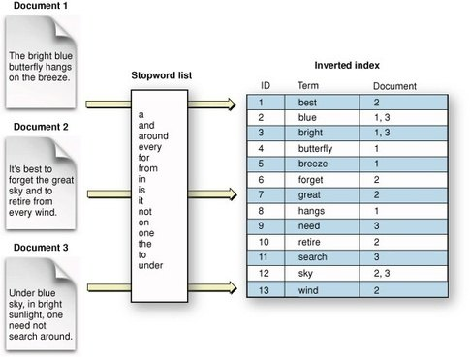
Indexing
Searching:
Inverted Index

Slide 53
Search Query
Logical “and” “not”
(曾俊華 and (教育 醫療)) not (林鄭 胡官)
Wildcard * ?
te?t
test*
Proximity
jakarta apache"~10 (search for a "apache" and "jakarta" within 10 words of each other in a document use the search)
Range
[20020101 TO 20030101]
{Aida TO Carmen}

Slide 54
Relevance & Sorting
What to display from the 1millions matched results?
TF-IDF (Term Frequency/Invert Document Frequency)
Google PageRank
Vector Space Model (Word Embedding)
Social Media Ranking

Slide 55
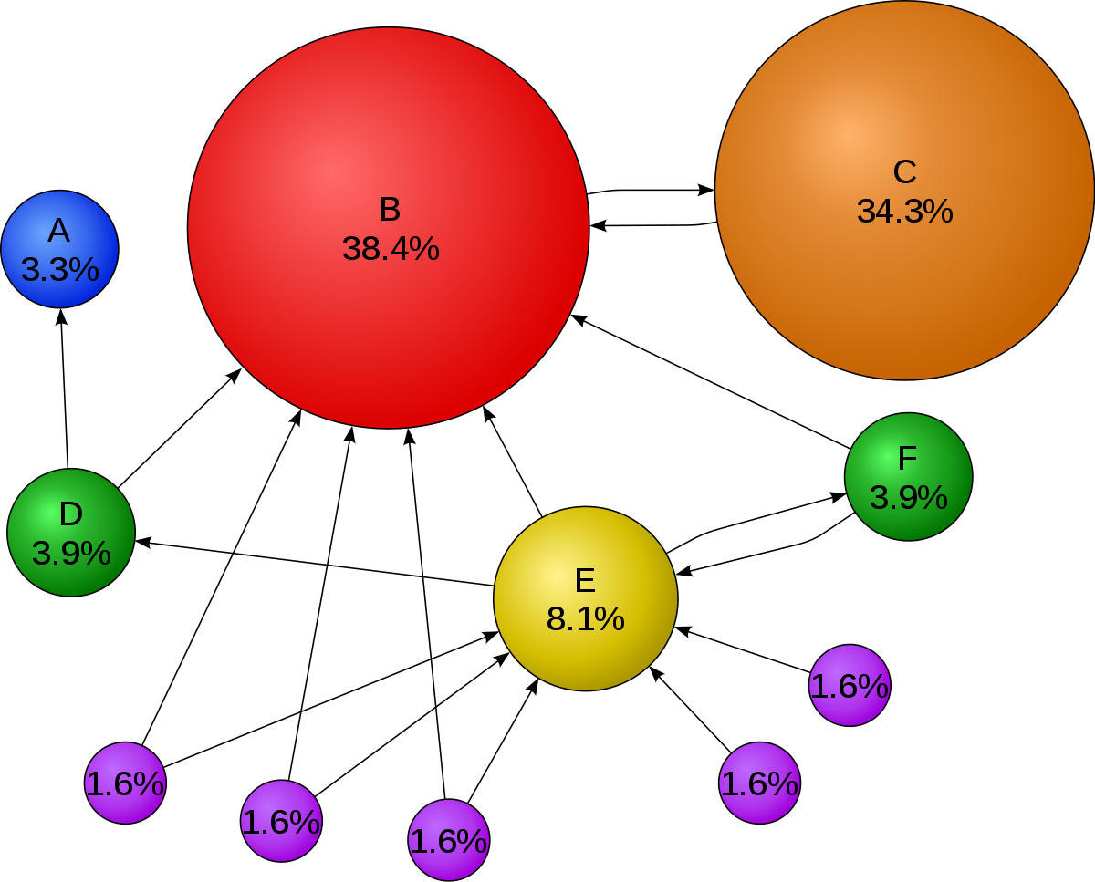
Google PageRank
Google realized that relevance for the web depended on trust, not just text
Search Engine Optimization (SEO): https://en.wikipedia.org/wiki/Search_engine_optimization

Slide 56
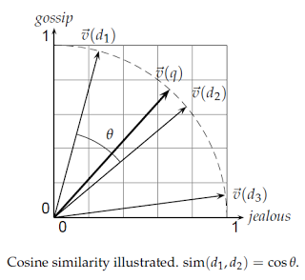
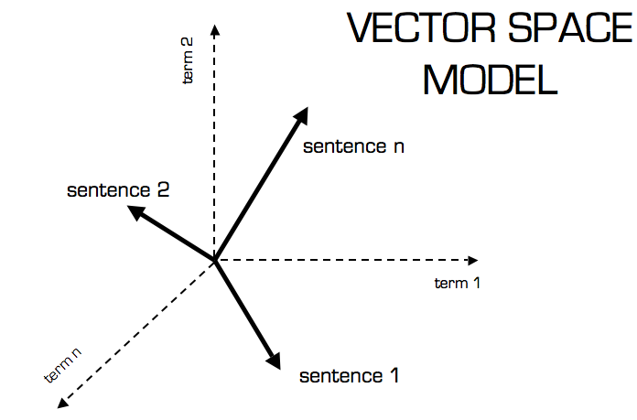
Vector Space Model (Word Embedding)
Representing text documents as vectors of identifiers. Each dimension corresponds to a separate term. If a term occurs in the document, its value in the vector is non-zero.
Use cosine similarity (e.g. dot product) to calculate the text similarity
Demo: http://projector.tensorflow.org/ Example: Search “大交合”

Slide 57
Social Media Ranking
Sort by Date
Sort by
Sort by Popularity Index
10*comment + 5*Love + 5*Angry + 4*Sad + 3*wow + 3*haha + 2*Comment_like + Page_like

Slide 58
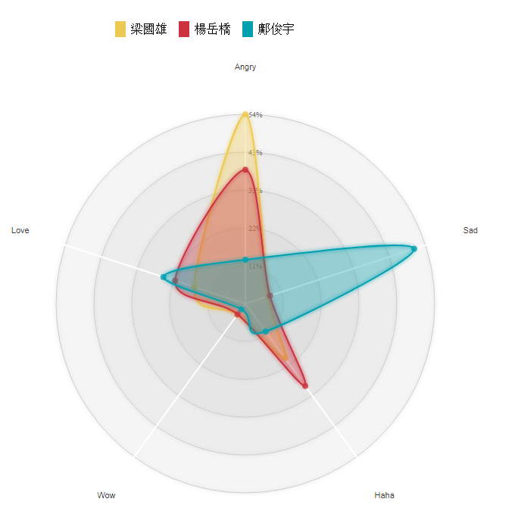
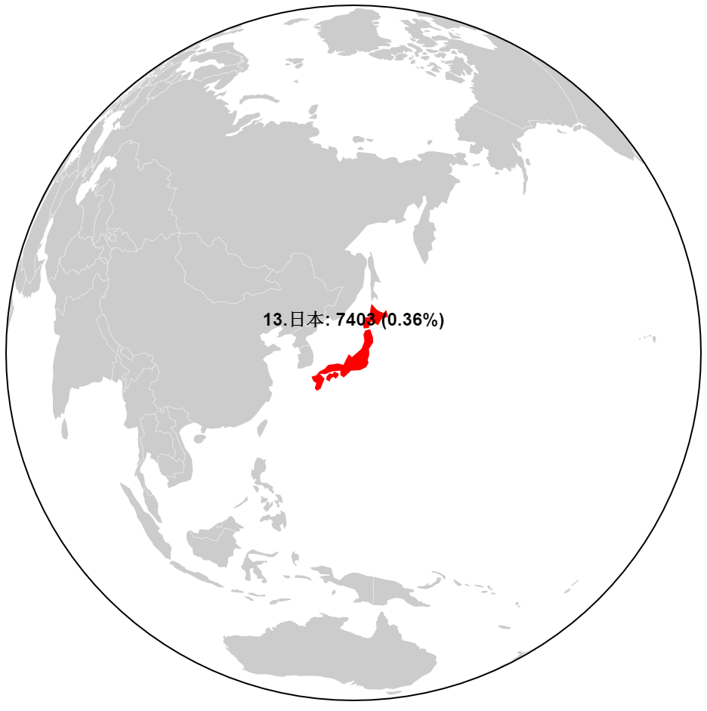
Visualization & Interpretation
Present the data in human readable format
Highlight the key points
User interaction
Examples: drill down to see more details

Slide 59
Visualization – D3.js
D3.js is based standard technologies
SVG, JavaScript and running on Browsers
Separate the data (binding) to the presentation
Support user interactions and animations effects
It’s free and has active communities
D3 galleries
https://github.com/d3/d3/wiki/gallery
(Tableau Software is free of charge if you upload your data to their server)

Slide 60

Discussion: Usage of Big Data Applications
About yourself, your work, your interests
And how can Big Data/AI help you

Slide 61
Datatact System and Architecture
IBM Bluemix Cloud
MySQL Database
Regular Expression
Lucene Index
Tomcat Web Server
Java Programming Language

Slide 62
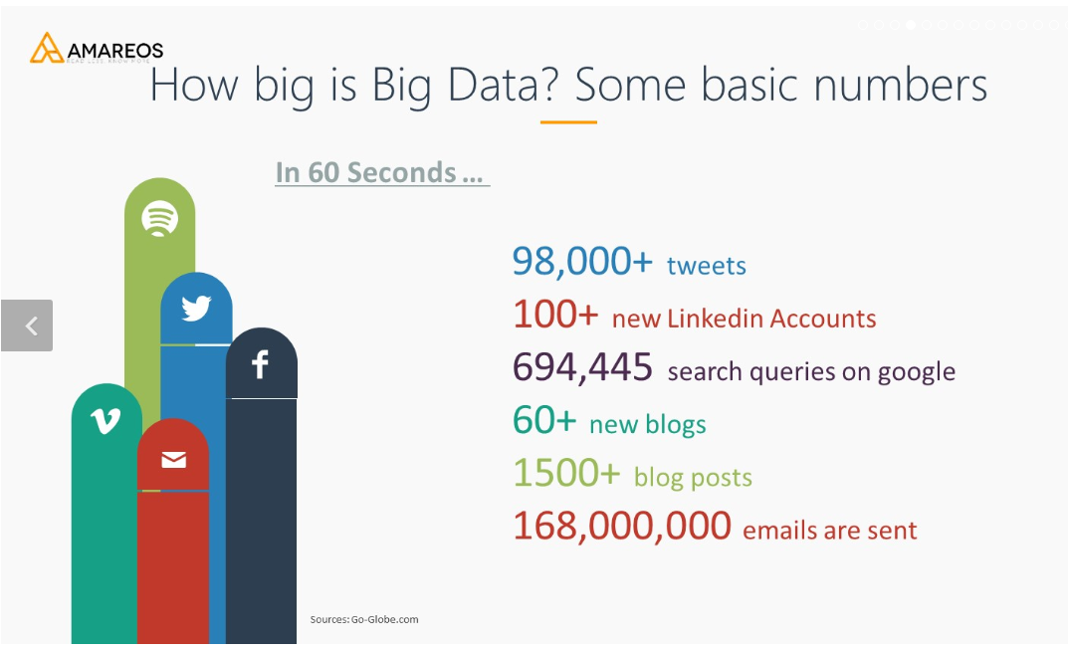
Big Data

Slide 63
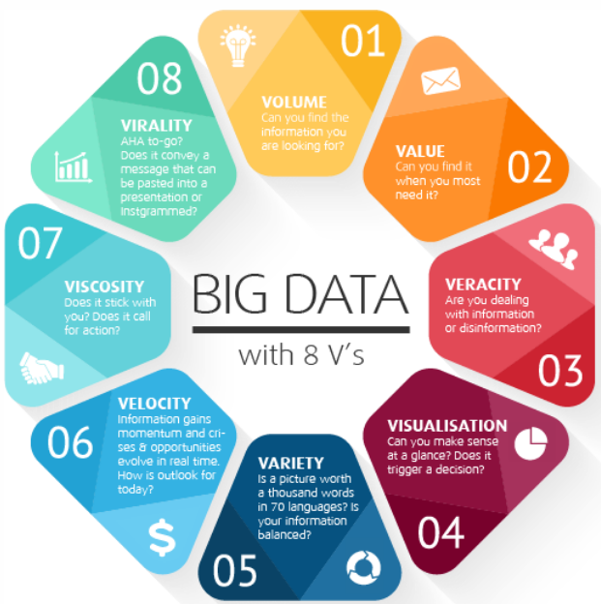
Big Data

Slide 64
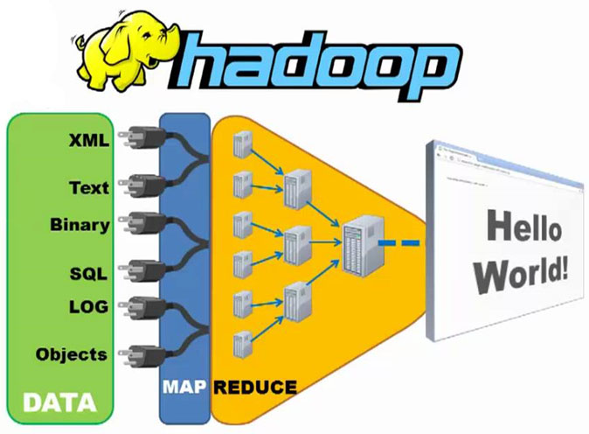
Key Technologies
Hadoop
Hashing
Map Reduce
SQL vs NoSQL

Slide 65
Hadoop
What exactly is Big Data
How big is big?
One possible answer: one computer cannot store all the required data (Moving “big” data around the network is extremely slow)
What is Hadoop
Distributed Filesystems
Map-reduce programming model
Do I need Hadoop?
Can one computer store all the data comfortably?
More transactions or more data queries?

Slide 66
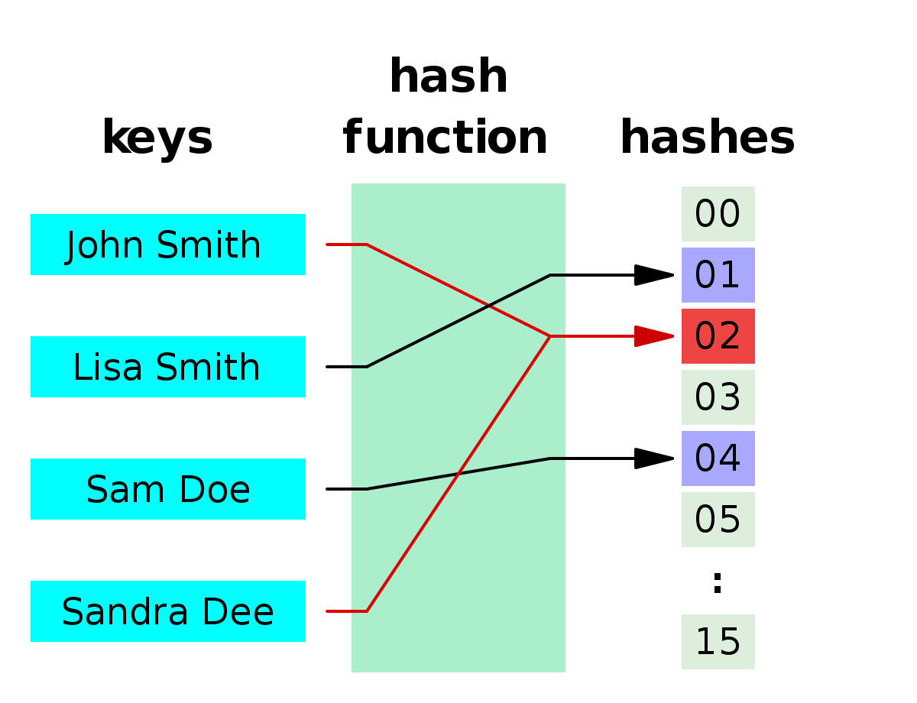
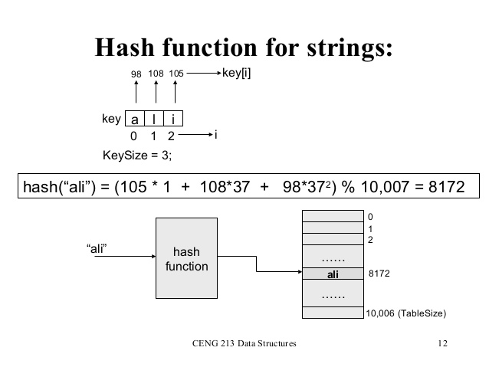
Hashing
Indexed by Calculation
One computer cannot host all the data and need to distribute into multiple computers (clusters of computers)
Hash function determine what data to store in which computer

Slide 67
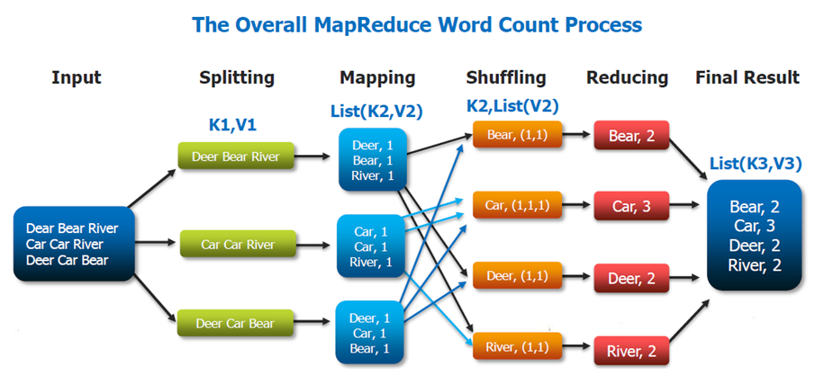
Map-Reduce
Data Parallelism
Moving the program to the data (rather than data to the program)
Split the task, compute sub results and combine them back for final result

Slide 68
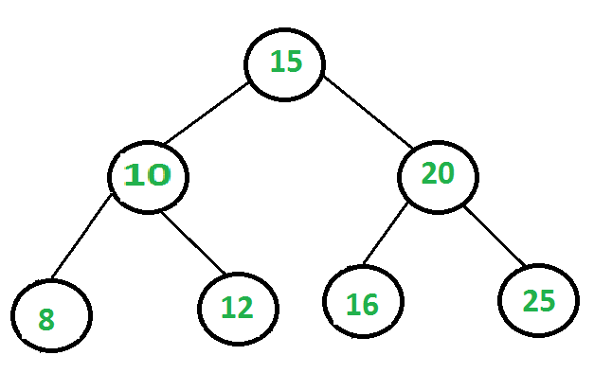
Tree
Searching and Sorting

Slide 69
SQL vs NoSQL Databases
ACID vs CAP
Atomic, Consistent, Isolated, Durable
Consistent, Available, Partition Tolerant
(CAP can’t have all three. In the face of network partitions, you can’t always have both perfect consistency and 100% availability.)
Relational (Table) vs Document/Graph/Key-Value
Schema vs Schema-less (Scheme-on-read)

Slide 70
SQL vs NoSQL Databases
Row oriented vs Columnar
Column values are physically together, efficiently read data from the whole column
OLAP vs OLTP
On-Line Analytical Processing
On-Line Transaction Processing

Slide 71
Do you need Big Data Solution
Are you a data company ?
Is your data growing exponentially (internet scale) or faster than the growth of single-disk storage capacity?
Is your data mostly immutable (i.e. write once, read many times)?
>> If not, probably you don’t need Hadoop or the related Big Data tech

Slide 72

Thank you

